Slide 1
Advanced MATLAB
By: Greg Ledingham

Slide 2
Overview
Data Types
Importing and Exporting Data
Subsetting/Manipulating Data
4. Analysis
Linear fitting
Nonlinear fitting

Slide 3
Basic MATLAB syntax
Semicolon stops line from being printed to console
Do this unless you want to see the result
Vectors stored with []
Strings/characters stored with {}

Slide 4
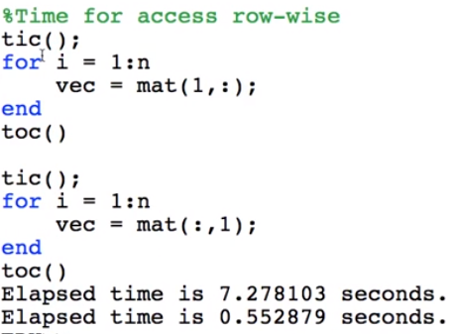
Optimizing code
MATLAB stores data columnwise, so it is much more efficient to access columns

Slide 5
Data types
Numeric
Single, double, NaN, Inf
Characters/strings
Tables
Structures
Cell Arrays
Function Handles
Hashmaps/dictionaries

Slide 6
Numerical: vectors/matrices
Most useful when cutting/pasting data
Vector1 = []; #empty vector
Vector1 = [10 20 30]; #3 columns, 1 row
Vector2 = [10, 20, 30]; #3 columns, 1 row
Vector3 = [10; 20; 30]; #1 column, 3 rows

Slide 7
Numerical: ways to create a vector
Ways of making the same vector
Other types of vectors
x1 = 1 : 1 : 5;
x2 = [1 2 3 4 5];
x3 = linspace(1, 5, 5);
x4 = logspace(3, 5, 10); %from 10^x1 to 10^x2 by 10 points
x5 = ones(1, length(variable));
x6 = zeros(1, length(variable));

Slide 8
Numerical: getting data from a matrix
Column 1 = matrix(:,1)
Row 1 = matrix(1,:)
Row 2, column 3 = matrix(2, 3)

Slide 9
Numerical: Sparse Matrix
S = sparse(A)
I = speye(m, n)#identity matrix
Sparse Matrices reduce storage space for “0” entries
Reduces computation time

Slide 10
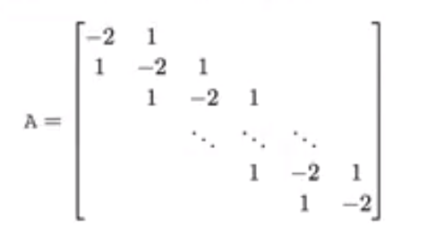
Sparse matrices
n = 1000;
Ad = diag(-2*ones(n, 1), 0) + diag(ones(n-1, 1), 1) ...
+ diag(ones(n + 1, 1), 1);
s1 = whos(Ad);
si.bytes
%8000000
n = 1000;
Ad = spdiags([ones(n-1), -2*ones(n, 1), ones(n, 1)], -1:1, n, n);
s2 = whos(Ad);
s2.bytes
%39980

Slide 11
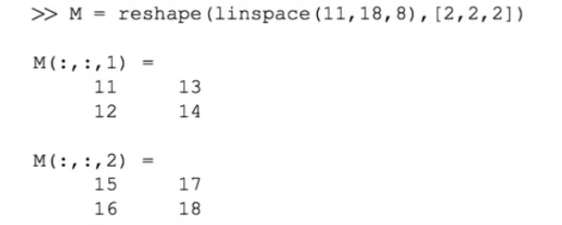
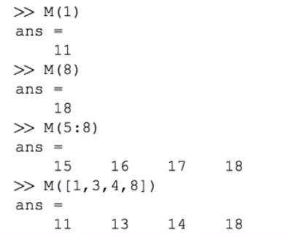
Example

Slide 12
Cell Arrays
Stores any data type, takes more memory
Construct with {} or cell
To access cell 1: c(1)
To access element in cell 1: c{1}
To access element 1 in cell 1: c(1{1})

Slide 13
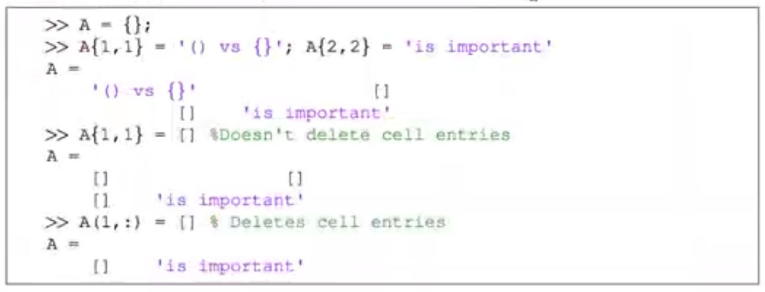
Cell Array example

Slide 14
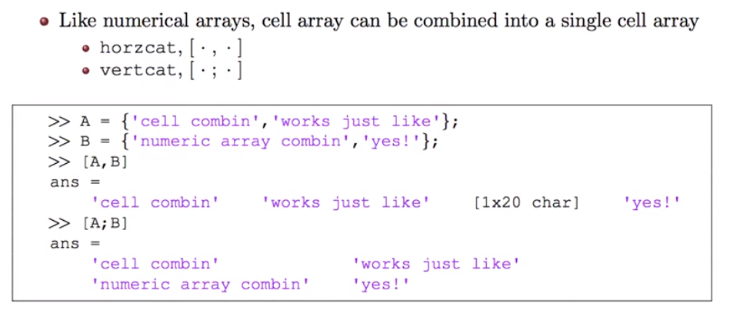
Cell Arrays

Slide 15
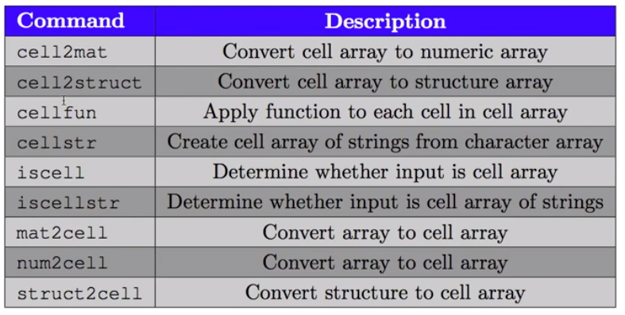
Cell Array conversion

Slide 16
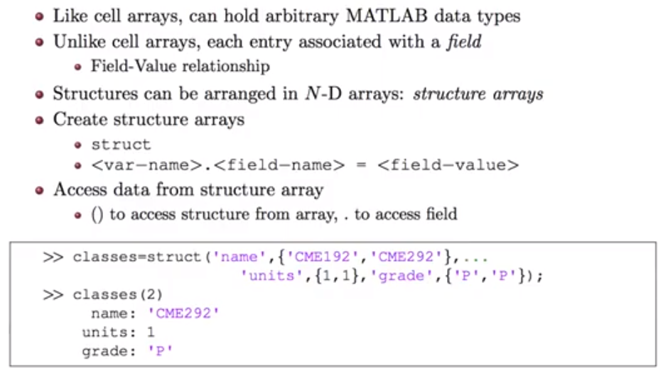
Struct

Slide 17
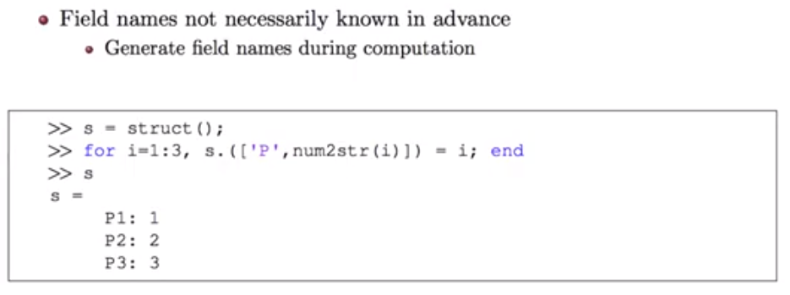
Struct: useful for importing files

Slide 18
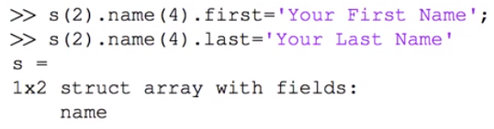
Struct example
Can have nested struct arrays

Slide 19
Functions
Useful for automating a process that you will do several times

Slide 20
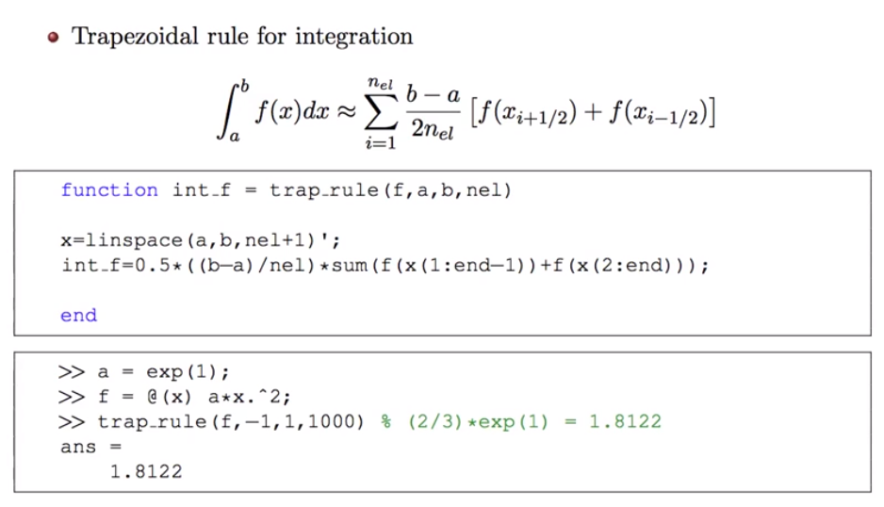
Functions example

Slide 21
Dictionary/Hashmap
Useful for fast computation and avoiding long for loops
Example: want average rainfall vs. daily river flow
Database only lists month but not average rainfall

Slide 22
Without Hashmap
month = ones(1, length(hydroMonth));
for i = 1:length(hydroMonth)
if strcmp(hydroMonth(i), 'January') == 1
month(i) = 121.4;
elseif strcmp(hydroMonth(i), 'February') == 1
month(i) = 317.6;
elseif strcmp(hydroMonth(i), 'January') == 1
month(i) = 424.2;
elseif strcmp(hydroMonth(i), 'April') == 1
month(i) = 323.9;
else
month(i) = 121;
end
end

Slide 23
With hashmap
keys = {'January', 'February', 'March', 'April', 'May'};
values = [121.4 317.6 424.2 323.9 121];
M = containers.Map(keys, values)
month = ones(1, length(hydroMonth));
for i=1:length(hydroData)
month(i) = M(hydroMonth(i));
end

Slide 24
Your turn
Discuss examples of data that would be best stored as struct, cell, numeric, etc. in your research

Slide 25
2. Importing and Exporting Data

Slide 26
xlsread
[NUM, TXT, RAW] = xlsread(FILE, SHEET, RANGE, ‘basic’)
Inputs
File: filename
Sheet = sheet number in Excel
Range = columns you want
‘basic’ if you aren’t using excel
Outputs
NUM = numeric data
TXT = text/strings
RAW = everything else

Slide 27
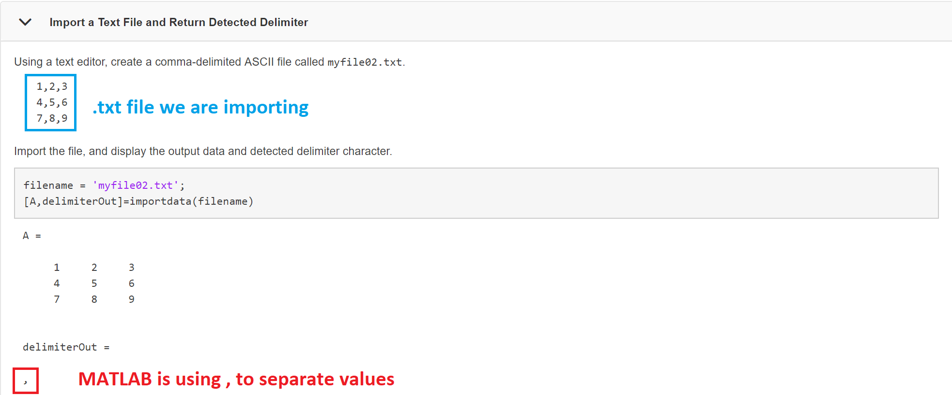
Import data

Slide 28
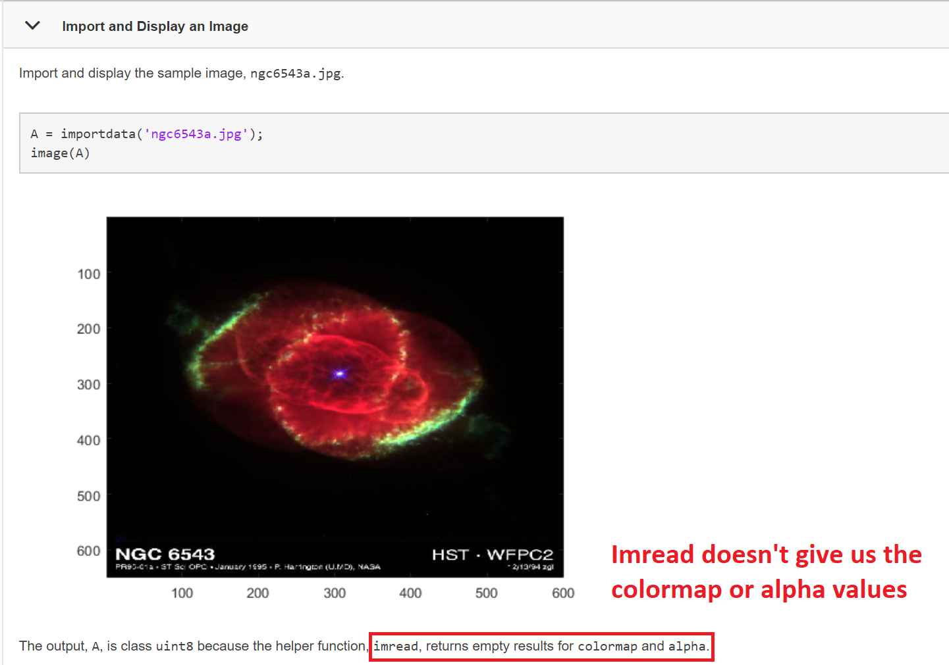
Import Data

Slide 29
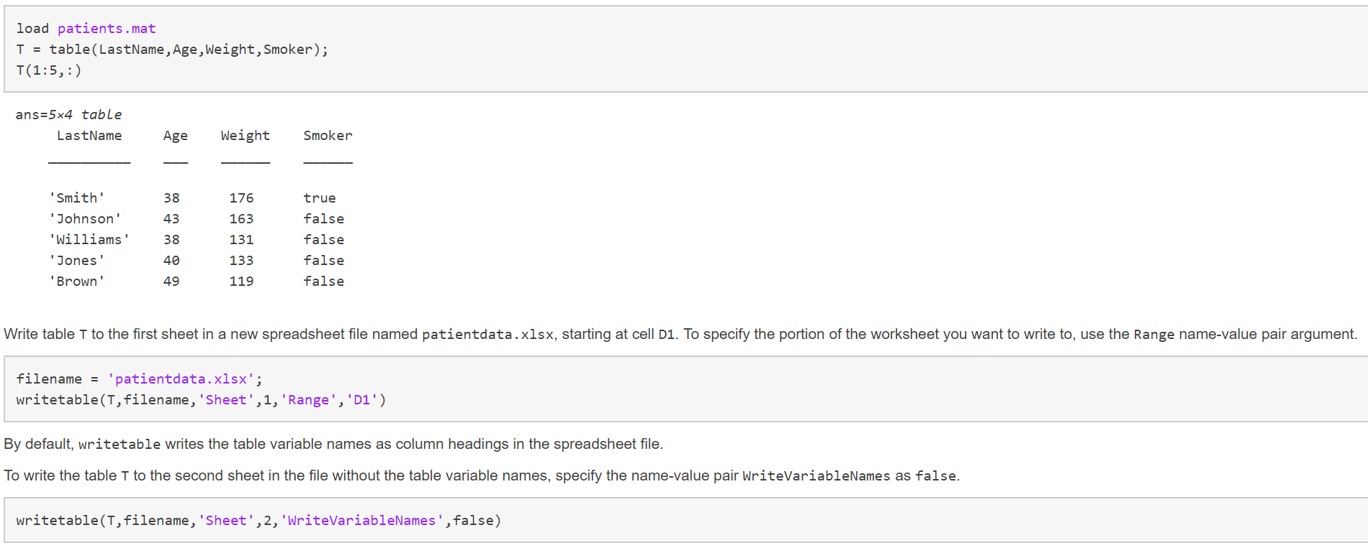
Write Table

Slide 30
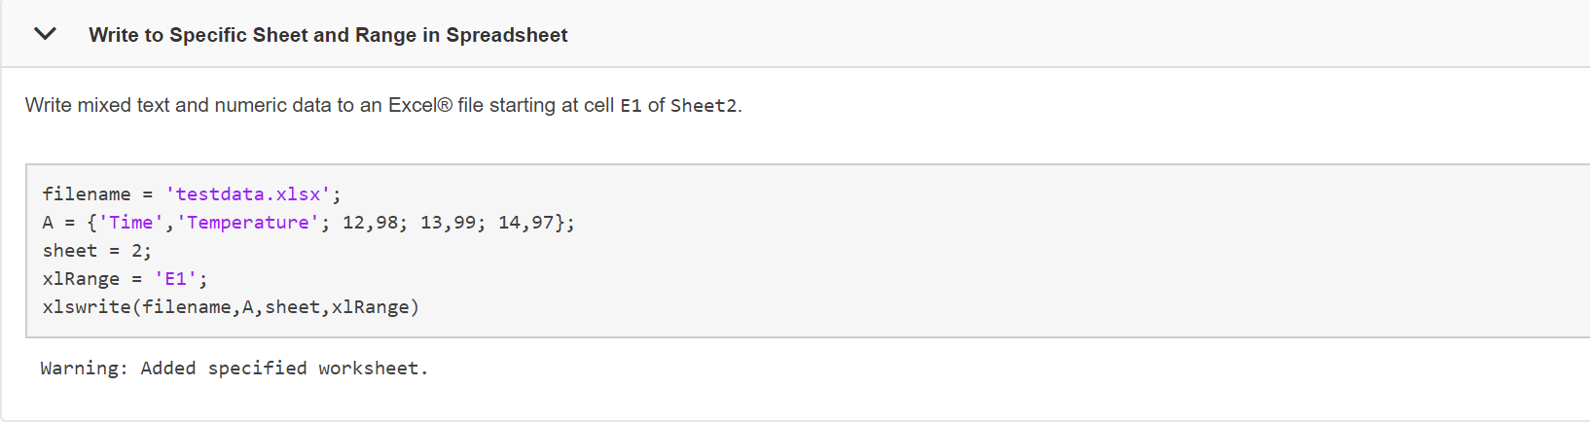
Write to xls file

Slide 31
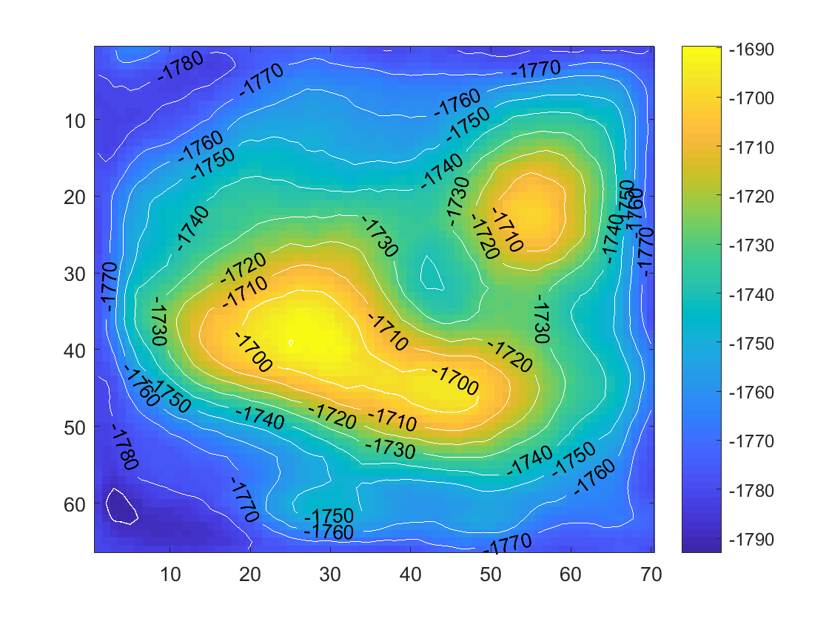
Example
addpath('C:\Users\Greg\Documents\GEOPHYS 112\dataintro.mat');
D = importdata('dataintro.mat');
logdata = D.('logdata');
tops = D.('tops');
topsvel = D.('topvel');
figure;
imagesc(tops);
colorbar;
hold on
[C, h] = contour(tops);
h.LineColor = 'w';
h.ShowText = 'on';

Slide 32
Your turn
Depth is the first column in logdata and porosity is the second column
Import ‘dataintro.mat’
Save porosity and depth data from structure
Plot porosity vs. depth
Include xlabel, ylabel, and title

Slide 33
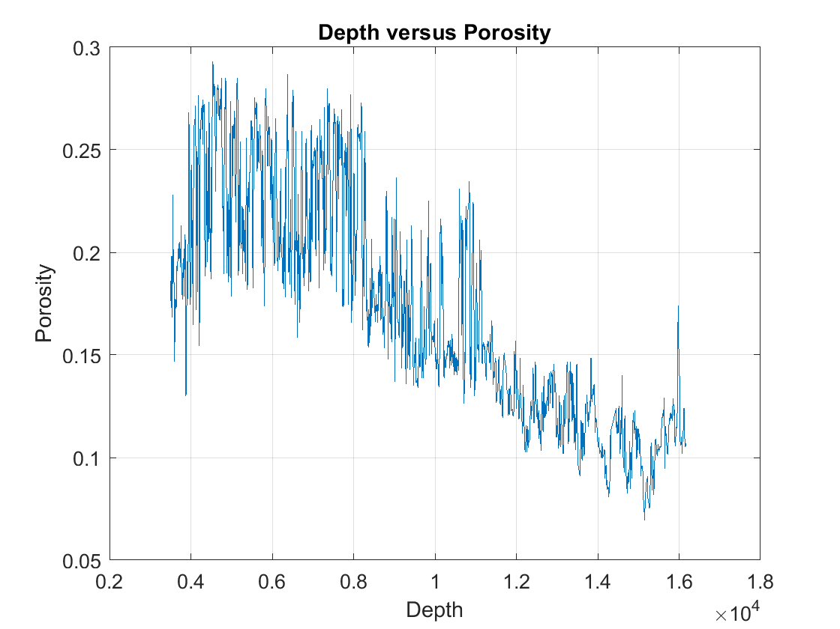
Answer
figure;
logdata = D.('logdata');
plot(logdata(:,1), logdata(:,2))
xlabel('Depth');
ylabel('Porosity');
title('Depth versus Porosity');
zoom on
grid on

Slide 34
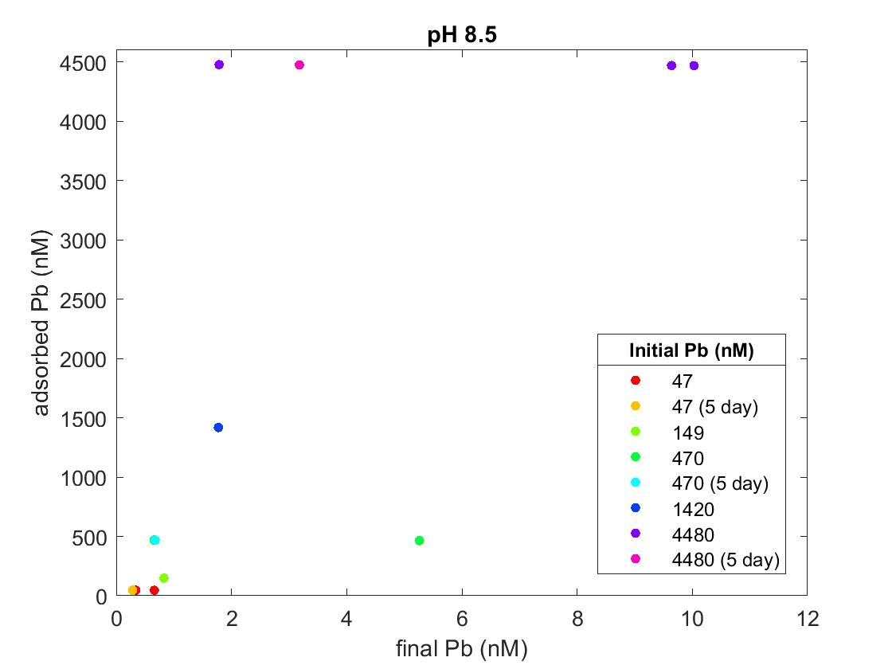
Visualization style 2: gscatter
figure;
gscatter(final_Pb, Ads_Pb, init_Pb)
ylim([0 4600])
xlim([0 12])
xlabel('final Pb (nM)')
ylabel('adsorbed Pb (nM)')
title('pH 8.5')
leg1 = legend('Location', 'Southeast');
title(leg1, 'Initial Pb (nM)');

Slide 35
Your Turn
Make a gscatter plot with:
X = depth
Y = Porosity
Color = Sonic velocity (column 3 of logdata)
Remove legend from graph

Slide 36
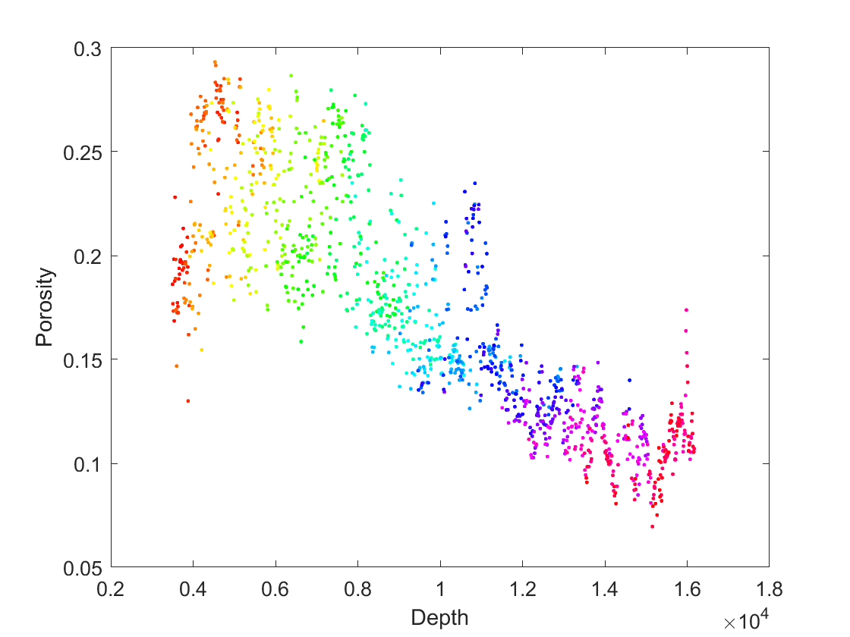
Answer
figure;
gscatter(logdata(:,1), logdata(:,2), logdata(:,3))
xlabel('Depth')
ylabel('Porosity')
leg = legend(p1);
set(leg, 'visible', 'off')

Slide 37
3. Subsetting
Getting the data that you want from a dataset
Examples:
Seismic profile: depth below weathering horizon
Geochemistry: δ¹³C values from only 580-500 Ma in dataset 700-200 Ma

Slide 38
Subsetting
calculations
max(A)
min(A)
sum(A)
length(A)
Logical
A(A >= 2.0) All A greater than or equal to 2.0
A(A > 2.0 & A < 1.5) All A not between 1.5 and 2.0
A(A > 2.0 || A < 1.5)

Slide 39
Your turn
1. Find the maximum value of porosity and the corresponding depth
2. Plot depth vs. porosity for depths greater than 10000

Slide 40
Answer-1
depth = logdata(:,1);
porosity = logdata(:,2);
[maxP, index] = max(porosity)
maxP
depth(index)

Slide 41
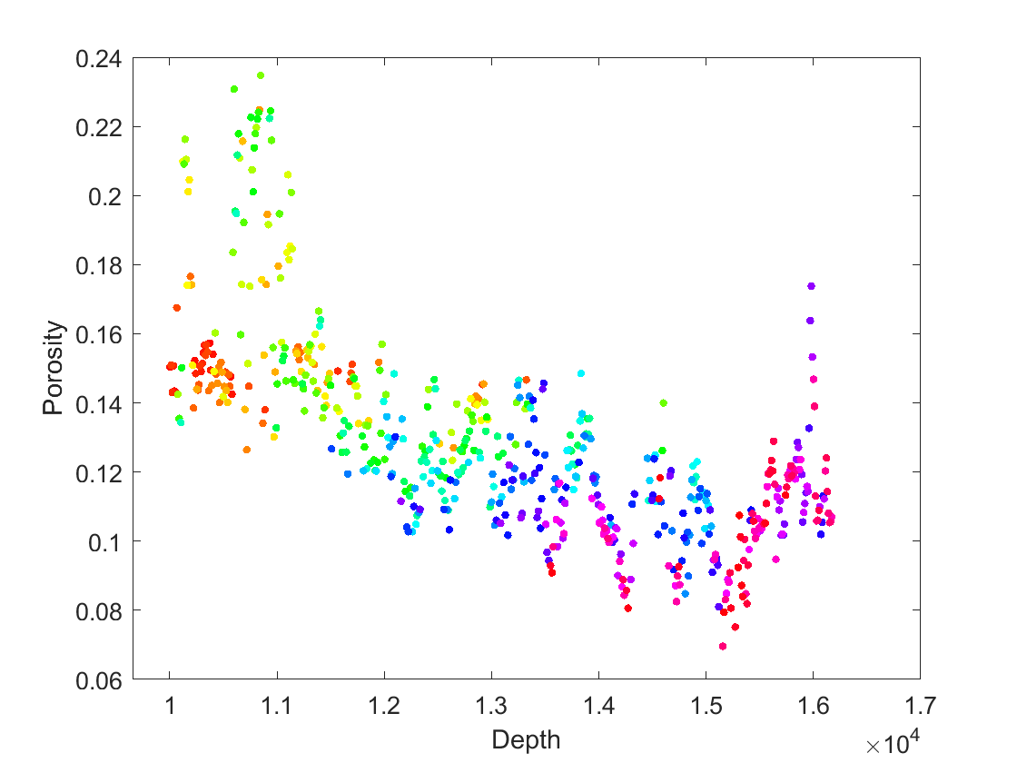
Answer-2
depth = logdata(:,1);
porosity = logdata(:,2);
sonicVel = logdata(:,3);
dep = depth(depth > 10000);
depthIndices = find(depth > 10000);
por = porosity(depthIndices);
son = sonicVel(depthIndices);
p1 = gscatter(dep, por, son);

Slide 42
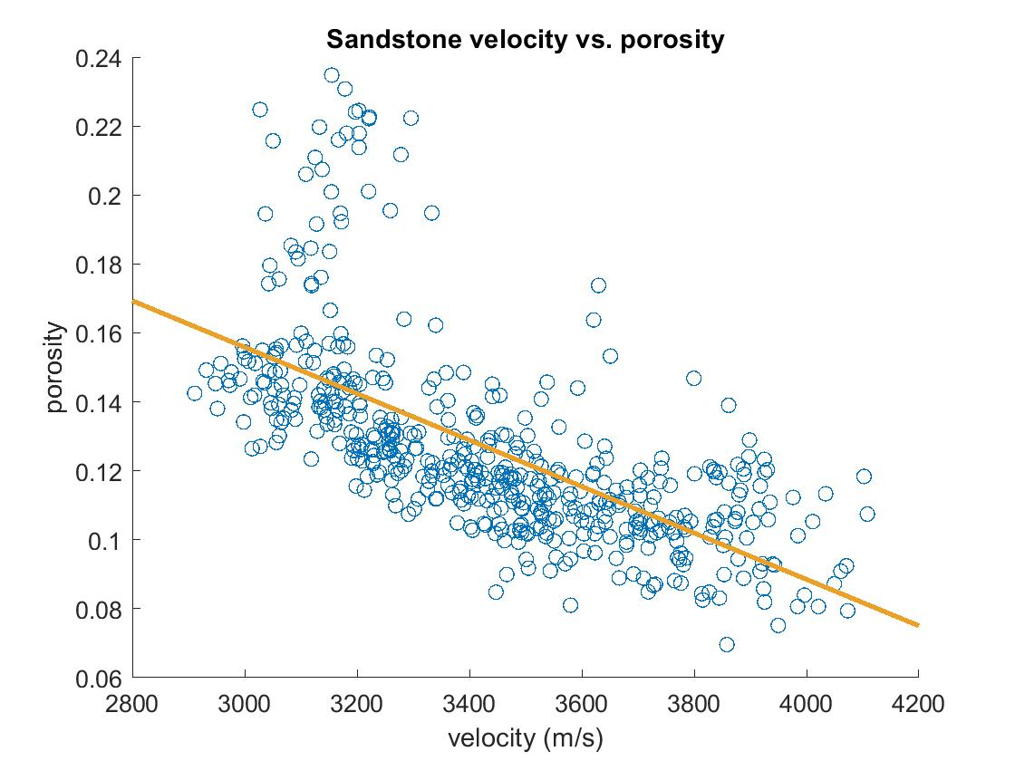
4. Linear and Nonlinear fitting

Slide 43
Linear Regression
addpath('C:\Users\Greg\Documents\SPR 2018');
R = importdata('regressiondata.mat');
vel1 = R.('velocity');
por1 = R.('porosity');
vel = vel1(end-499:end);
por = por1(end-499:end);
x1 = vel\por;
size(vel)
size(por)
%The matrix is determined; we have the same number of equations as
%unknowns. Both vel and por are 500 by 1 matrices, thus vel\por yields an
%exact solution. The backlash operator solves an equation of the form Ax=b
%using LU factorization, the inverse method, or whatever MATLAB determines
%is the most efficient to obtain a solution.

Slide 44
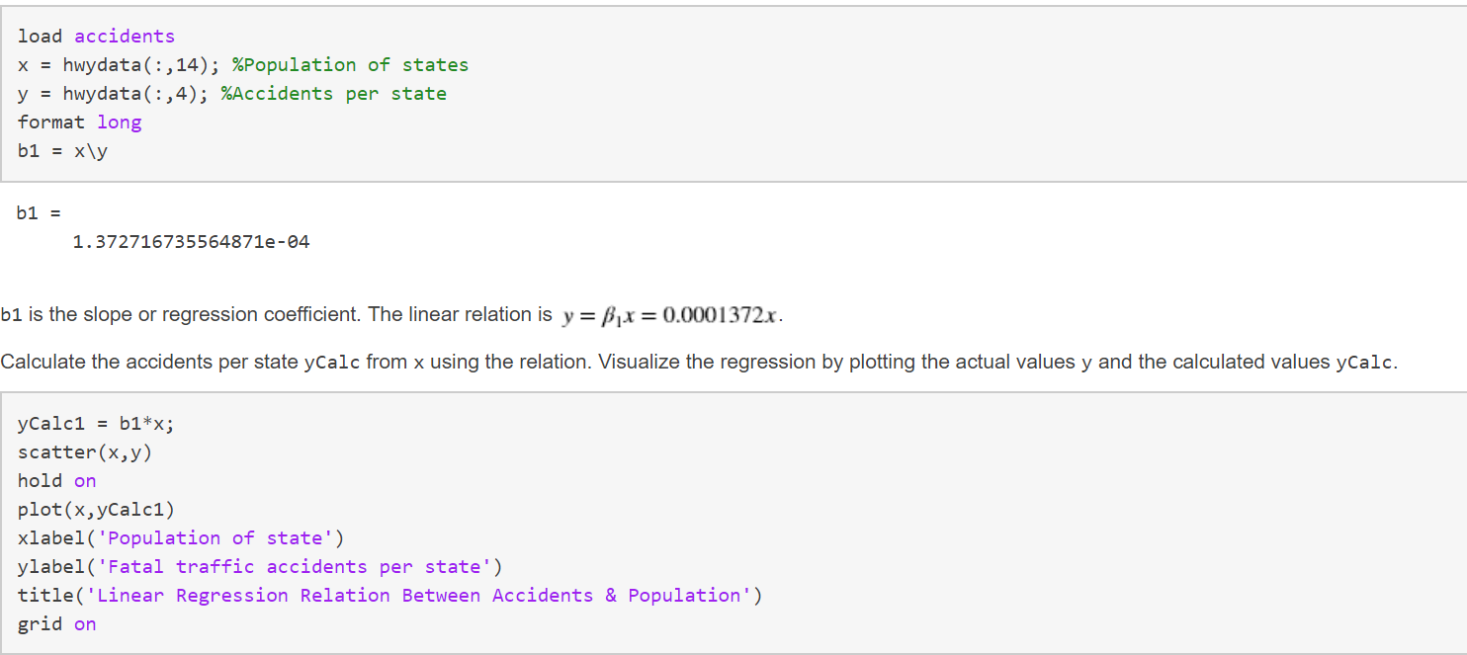
Linear Regression

Slide 45
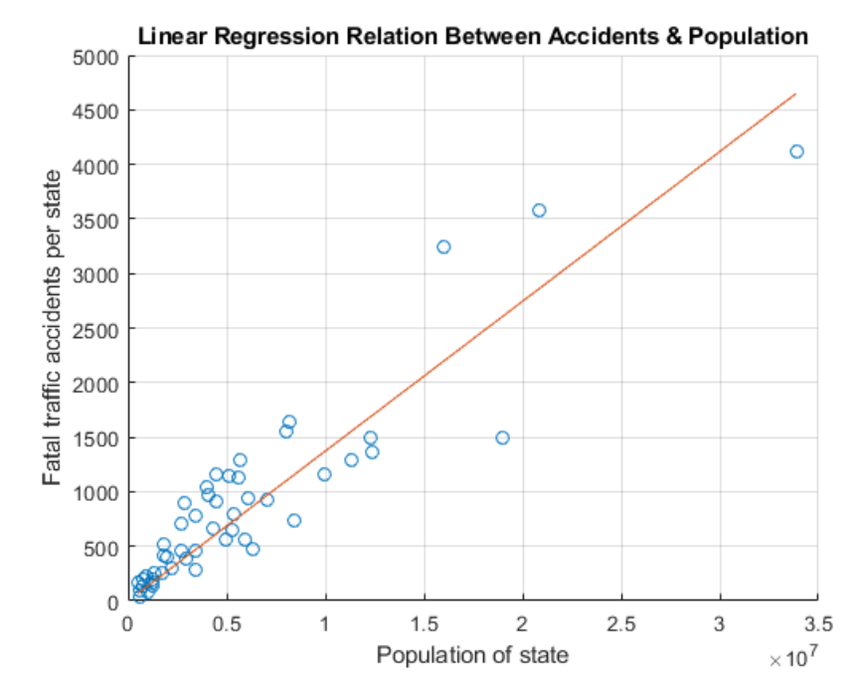
Linear Regression

Slide 46
Linear Fitting
linreg = x1*vel;
figure;
scatter(vel, por);
hold on
lin = lsline;
orange = [235 160 39]./255;
lin.Color = orange; lin.LineWidth = 2;
xlabel('velocity (m/s)')
ylabel('porosity')
title('Sandstone velocity vs. porosity')

Slide 47
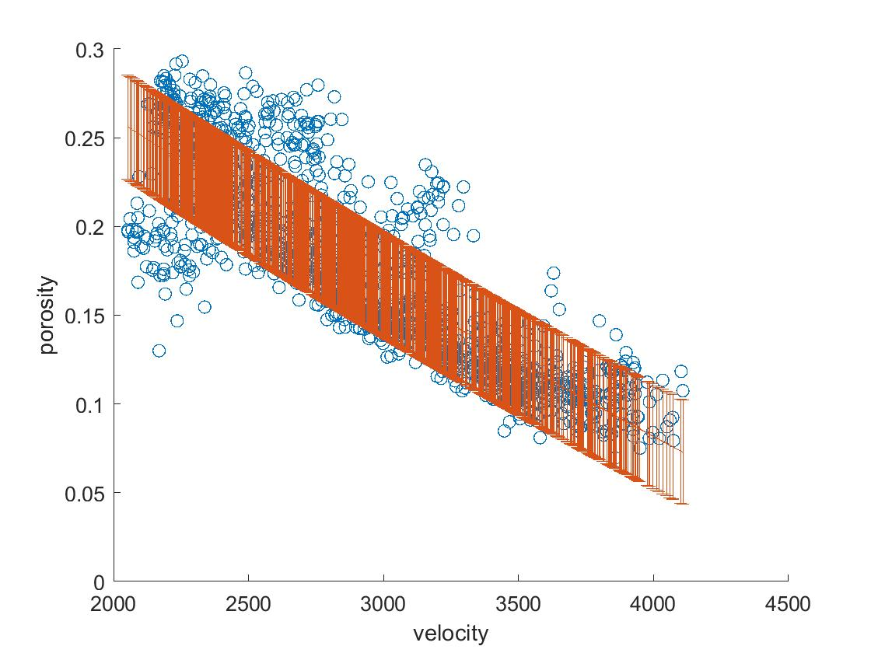
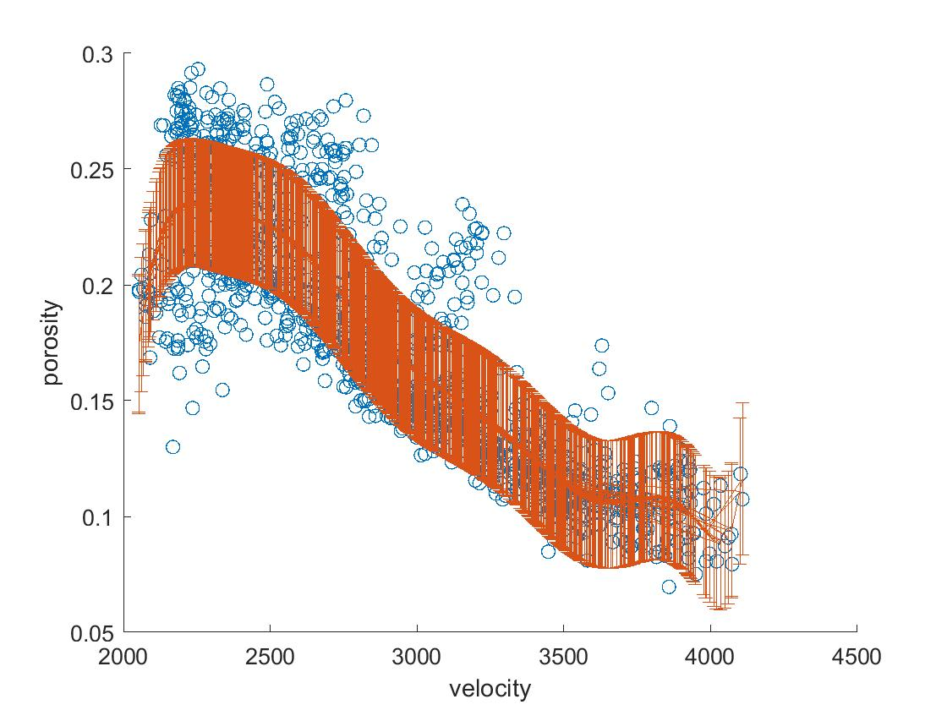
Polynomial fitting
[p, S] = polyfit(vel1, por1, 10); %last number = power
[f, delta] = polyval(p, vel1, S);
figure;
scatter(vel1, por1)
hold on
errorbar(vel1, f, delta);
xlabel('velocity')
ylabel('porosity')
Fit to x²
Fit to x¹⁰

Slide 48
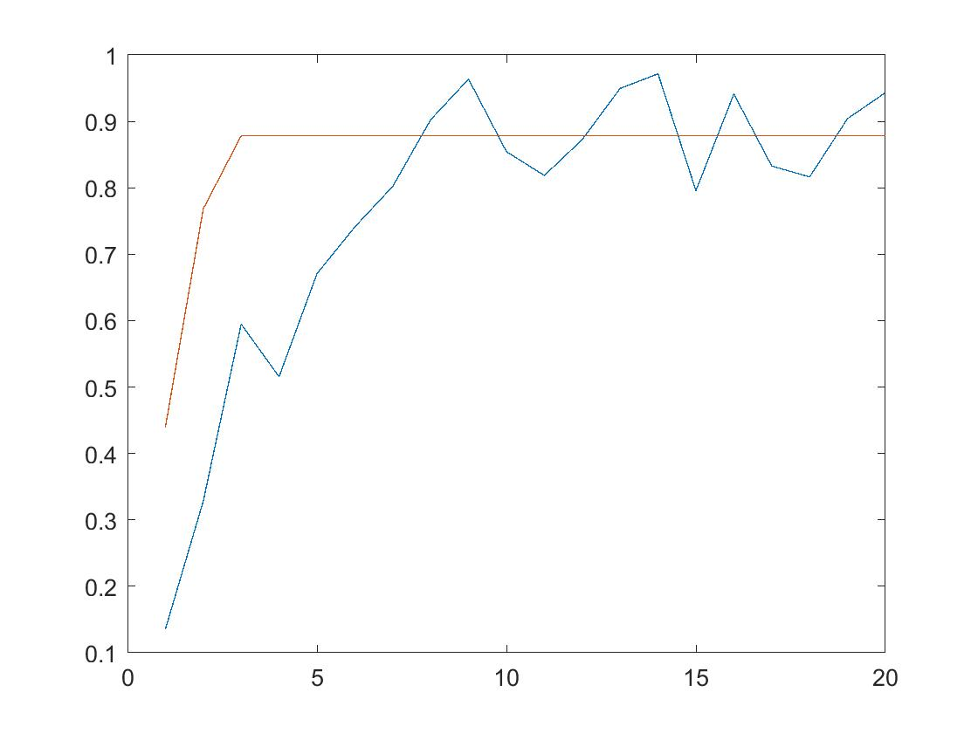
Nonlinear Fitting
Ways of fitting data that is non-polynomial and nonlinear
lsqnonlin
fminsearch
optimtools

Slide 49
Fit optimization
opts = optimoptions('fminunc');
opts = optimoptions('fminunc','algorithm','quasi-newton');
opts = optimoptions(opts, 'Display' ,'iter');
[aopt, copt] = fminunc(@(lag) vario(a, c, lag, var), 1, opts);
aopt
copt
%aopt = 5.7528
%copt = .9371

Slide 50
Nonlinear fitting
R = importdata('regressiondata.mat');
vrgdata = R.('vrgdata');
lag = vrgdata(:,1);
var = vrgdata(:,2);
a = 5;
c = 1;
[a2, c2] = lsqnonlin(@(lag) vario(a, c, lag, var),0);
yNew = zeros([1 length(lag)]);
for j=1:length(lag)
if lag(j) < a2
yNew(j) = c2*(1.5*(lag(j)/a2) - 0.5*(lag(j)/a2)^3);
else
yNew(j) = c2;
end
end
figure;
plot(lag, var)
hold on
plot(lag, yNew);
Import data
Function we are fitting to

Slide 51
function [yErr2] = vario(b)
addpath('C:\Users\Greg\Documents');
R = importdata('regressiondata.mat');
vrgdata = R.('vrgdata');
lag = vrgdata(:,1);
var = vrgdata(:,2);
yPred = zeros([1 length(lag)]);
for i = 1:length(lag)
if lag(i) < b(1)
yPred(i) = b(2)*(1.5*(lag(i)/b(1)) - 0.5*(lag(i)/b(1))^3);
else
yPred(i) = b(2);
end
end
yErr = (var-yPred');
yErr2 = sum(yErr.^2);
norm(yErr);
%norm of residuals (yErr) = .9681
end

Slide 52
Your turn
Open ‘variogram.mat’ and play around with the a and c parameters to see how they change the fit

